Slide 1

Peer Tutoring Training
TWC & LEC

Slide 2
Contents
1
Imago Dialogue
2
Types of Mirroring
3
Empathizing and Roleplaying
4
The Tutoring Session
5
The Socratic Method

Slide 3
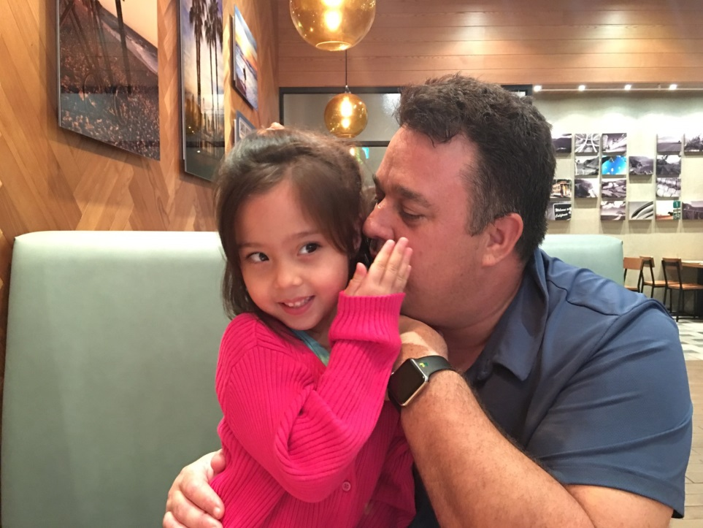
Imago Dialogue
Designed by Dr. Harville Hendrix – Austin College
Purpose to use body language combined with the receptive process of hearing to create effective dialogue in a nonjudgmental manner through the concept of mirroring.
Considered to be a highly effective peer tutoring tool in communicating with learners.

Slide 4
Diagram
Promotes logical thought
Provides validation to the student
Seeks to empathize with the student
Imago Dialogue promotes the mirroring process with the aim of accurately reflecting back the message to a student who has shared an experience or opinion.
Text
Text
Benefits
of Imago
Text
Text
Text
Text
NONJUDGMENTAL

Slide 5
Types of Mirroring
Concave
Mirroring
Flat
Convex

Slide 6
Types of Mirroring
Flat
Convex
Concave
Ability to repeat the content of a message to a student accurately.
VERY DIFFICULT TO ACHIEVE...PEOPLE TEND TO ADD A LITTLE MORE THAN WHAT WAS SAID, AND A LITTLE LESS.
Occurs when something has been added to the message, thus altering the interpretation.
OFTEN HAPPENS FOR THE PURPOSE, CONSCIOUS OR NOT, TO SHAPE THE OTHER PERSON’S THOUGHTS AND FEELINGS.
Occurs when something has been omitted or left out of the message, thus altering the focus.
OFTEN HAPPENS WHEN THE LISTENER HIGHLIGHTS ONE THING THEY THINK IS IMPORTANT, BUT OMIT WHAT THE SPEAKER REALLY THINKS IS MOST IMPORTANT

Slide 7
Examples of Mirroring
Student: “I find learning Arabic difficult.”
Peer Tutor: “Ah, I know it can be difficult to learn at times..”
Flat
Student: “I find speaking English to be very challenging“.
Peer Tutor: “Learning to speak English in not easy, but you must learn it because it is an international language.”
Concave
Student: “I find mathematics to be extremely difficult to understand.”
Peer Tutor: I know... you must have difficulty with adding and subtracting.”
Convex

Slide 8
Problems with Convex
& Concave Mirroring
If our mirroring is based on errors of understanding,
then our interpretation will be wrong
We think we are paraphrasing what another person is saying...
Misinterpret
&
Misunderstand
Judge
&
Project
Assume
Guess

Slide 9
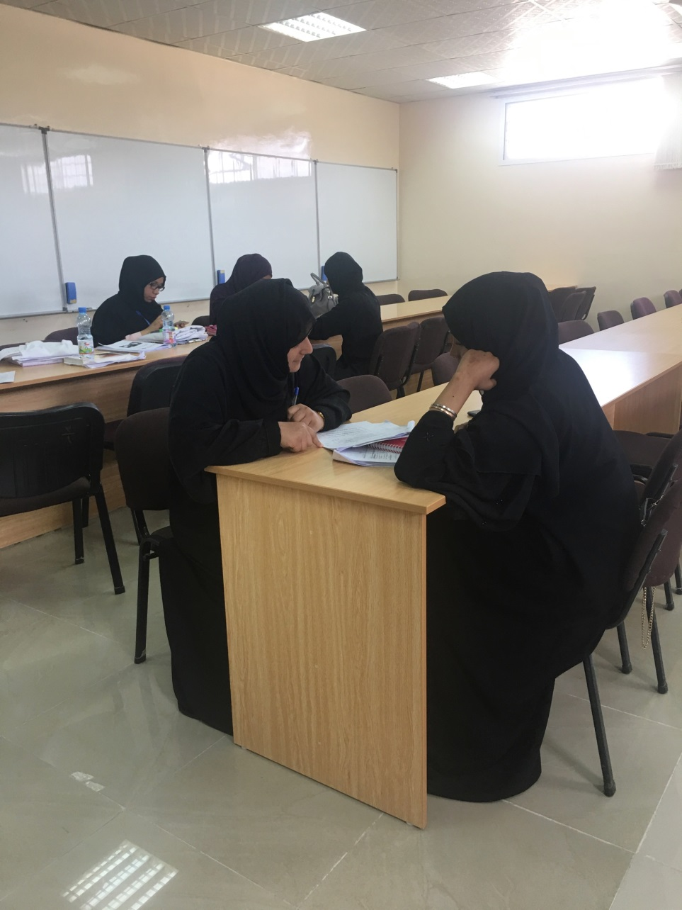
Flat Mirroring Advice
Flat mirroring lets students know that you are putting aside your own thoughts and feelings for the moment in order to understand their point of view.

Slide 10
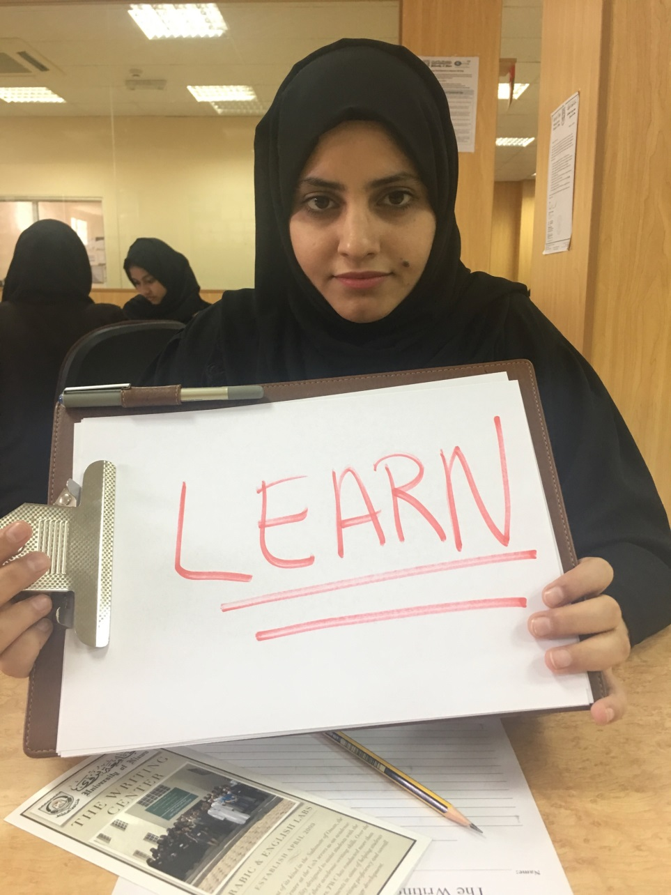
Advice for Peer Tutors
Always confirm by asking follow-up questions to ensure accuracy and understanding of the student’s intent and learning.
NEVER GUESS OR ASSUME...

Slide 11
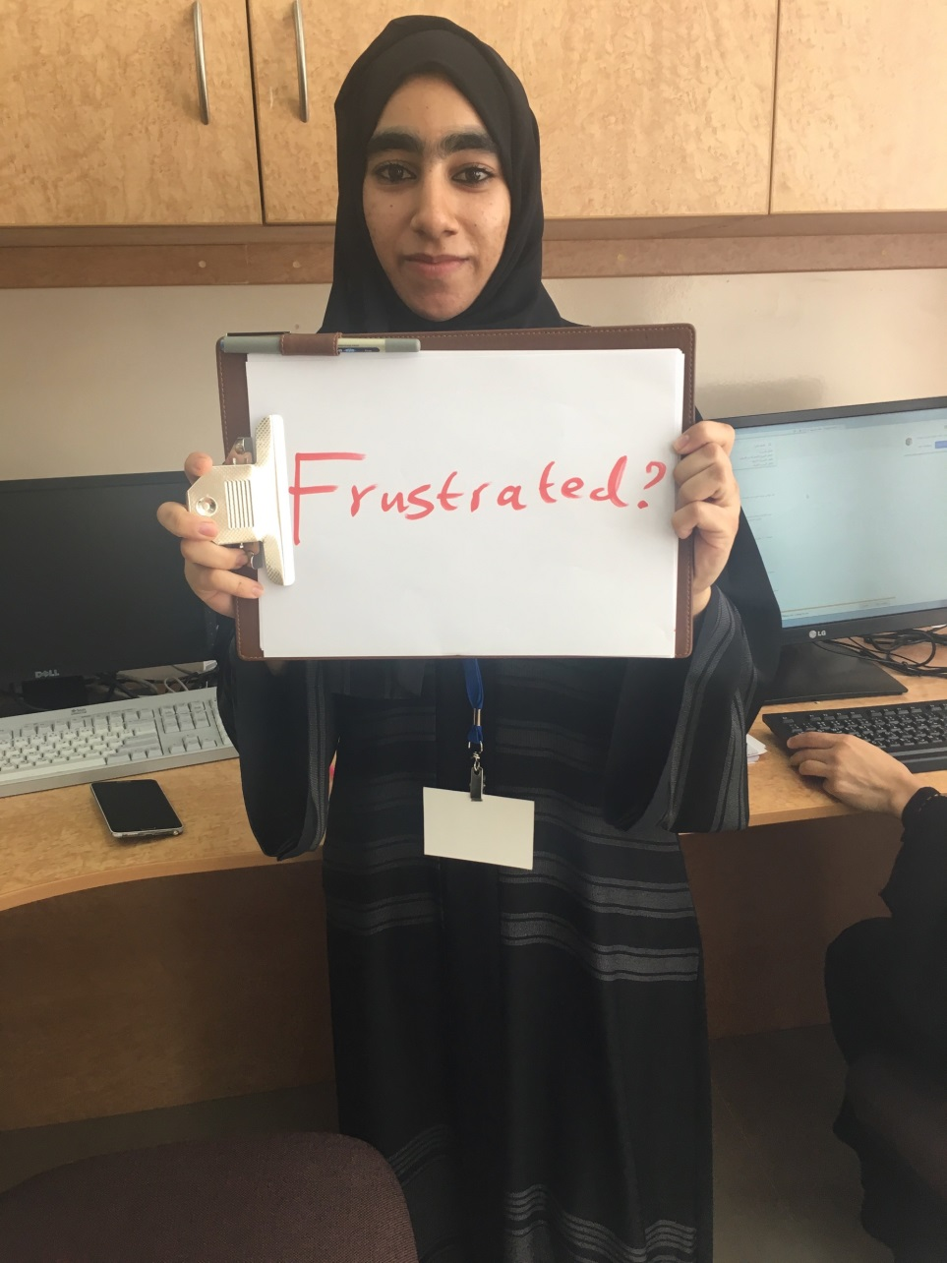
Building Relationships
Flat mirroring provides opportunity for peer tutors a rare moment of self-transcendence. It allows for safety, and a deeper emotional connection in your relationship with tutees.

Slide 12
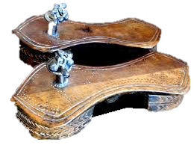
Empathy...putting yourself in somebody else’s sandals

Slide 13
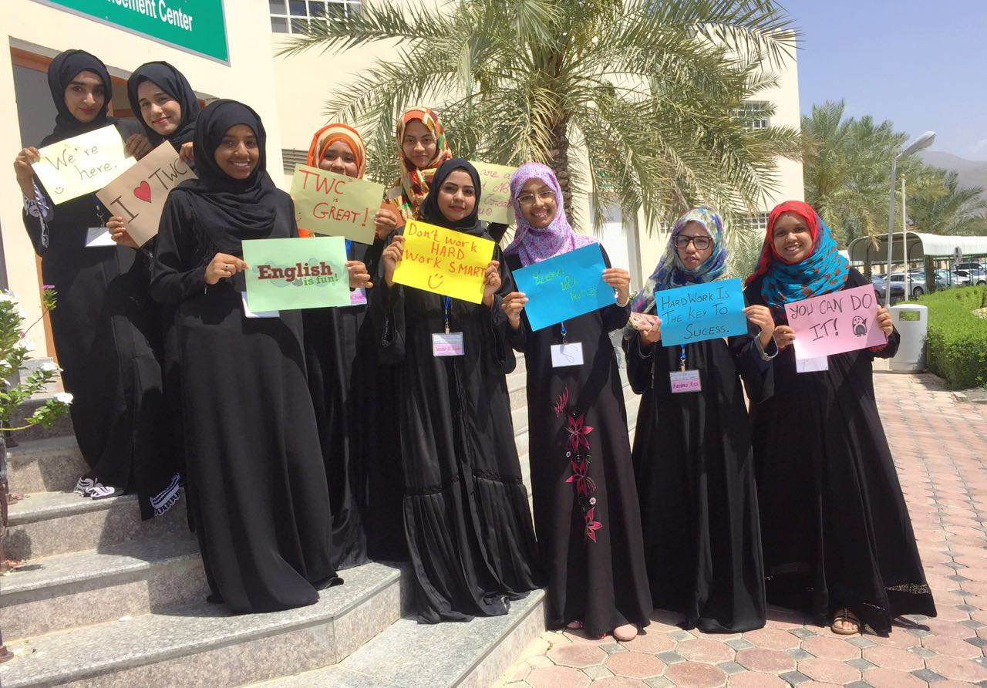
Empathy
Empathizing is the process of recognizing feelings of another person while s/he is expressing a point of view or opinion.

Slide 14
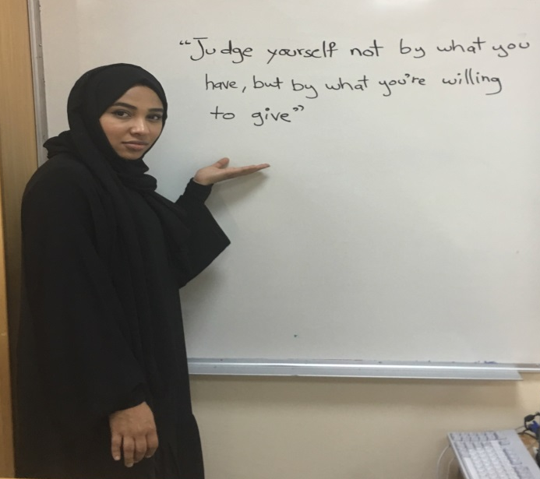
Types of Empathy
1st First Level
2nd Second Level
Peer tutors reflect and imagine the feelings the student is expressing
Peer tutors have a deeper level of feeling that emotionally connects with the student. The peer tutor actually feels what the student is experiencing.

Slide 15
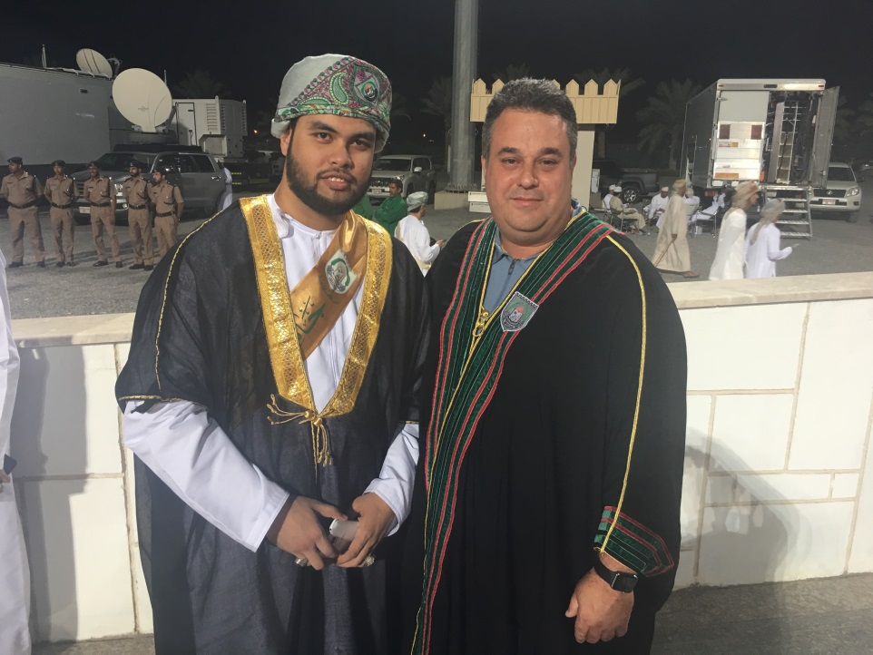
Empathy Expressions
I can imagine that you might be feeling....
I can see that you are feeling...
....., is that what you are feeling?
I want to be sure that I understand you correctly.
I can understand how you are feeling these days.
I empathize what your are going through.
Relate, Sympathize, Identify, Compassion

Slide 16
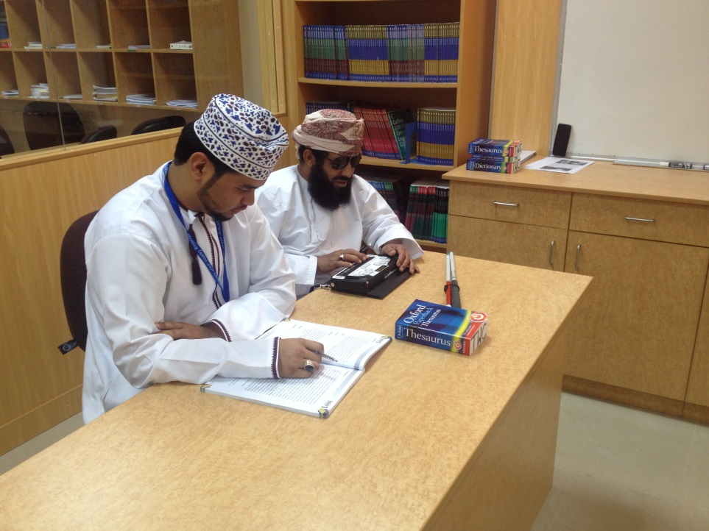
Advice on Empathy
Empathic experiences are very powerful, independent from what is communicated.
When peer tutors engage students, they can see the world through their tutee’s eyes.

Slide 17
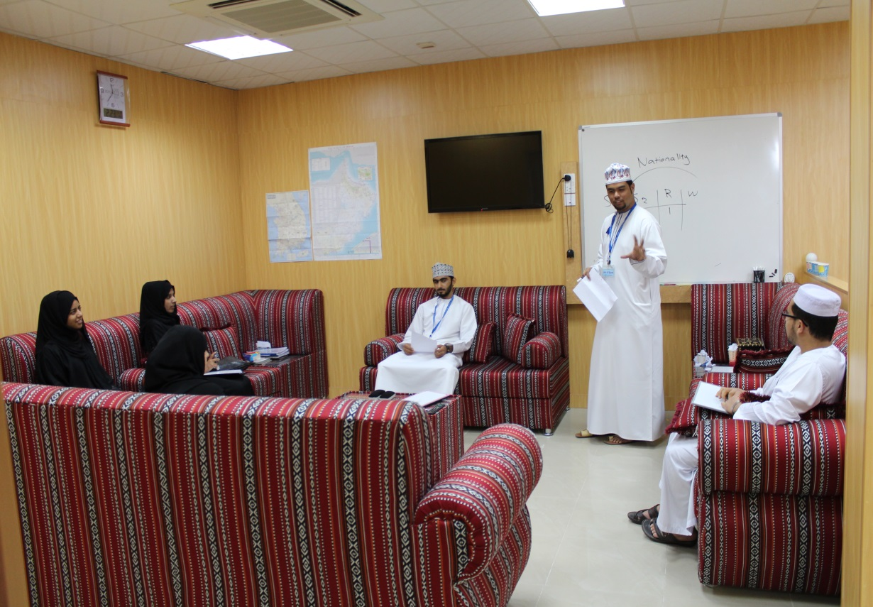
Roleplaying...time to partner up with someone.

Slide 18

5 Minute Roleplaying
Partner up with another peer tutor...preferable someone you don’t know well.
One peer tutor expresses a personal feeling that they had in the past week.
The other peer tutor listens, then practices a flat mirroring response and emphasizes with their partner in a brief discussion.
Then, switch roles and allow for the other peer tutor to take a turn.

Slide 19
Socratic Method: “Give a man a fish and he will eat for a day. Teach a man to fish and he will eat for the rest of his life.”

Slide 20
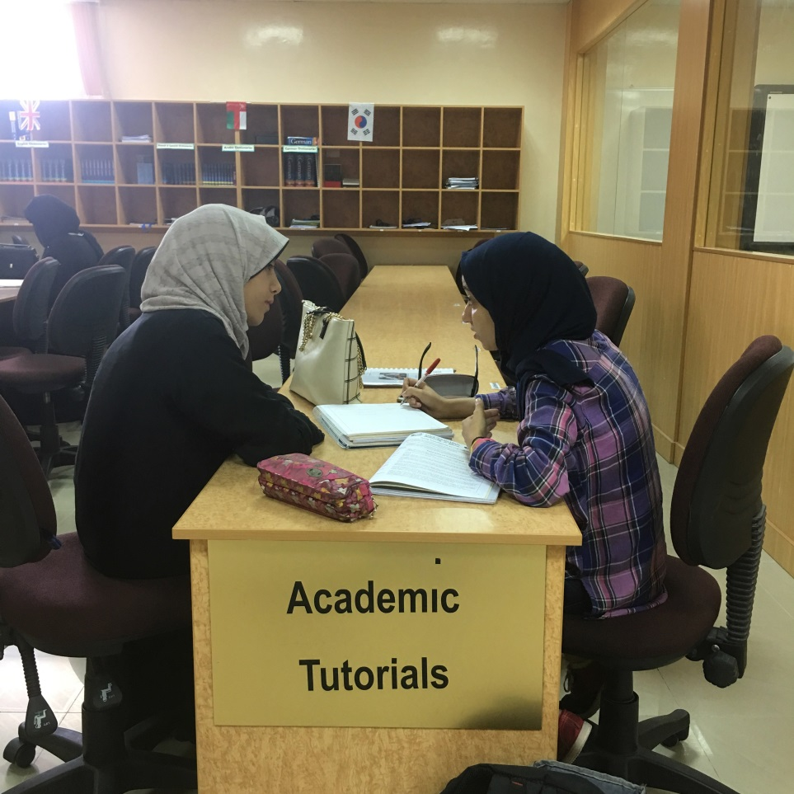
Socratic Method
While tutoring, the Socratic Method promotes asking questions to students to all them to discover connections and errors on their own, rather than from the peer tutor.

Slide 21
Self Discovery
Peer Tutors should ask more questions, and explain less.
Why
When
What
Questions
How
Is, Are,
Which
Where
Who

Slide 22
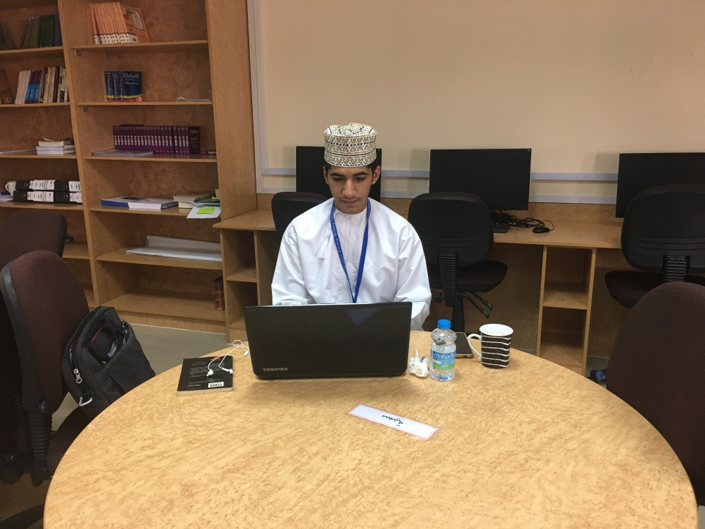
Applying the Socratic Method
Peer tutors can help student learn faster by fostering student independence through stimulating cooperative learning and building the student’s self confidence in their own abilities.
Peer tutors can use this method to determine a student’s level of comprehension of information before moving onto new ideas and concepts.

Slide 23
Review & Error Correction
Flat Mirroring
Concave Mirroring
What do
you
remember?
Socratic Method
Convex Mirroring
Roleplaying
Empathy

Slide 24
Thank You !
Hope you can apply what you learned in your peer tutorials at TWC & LEC ☺

